Slide 1
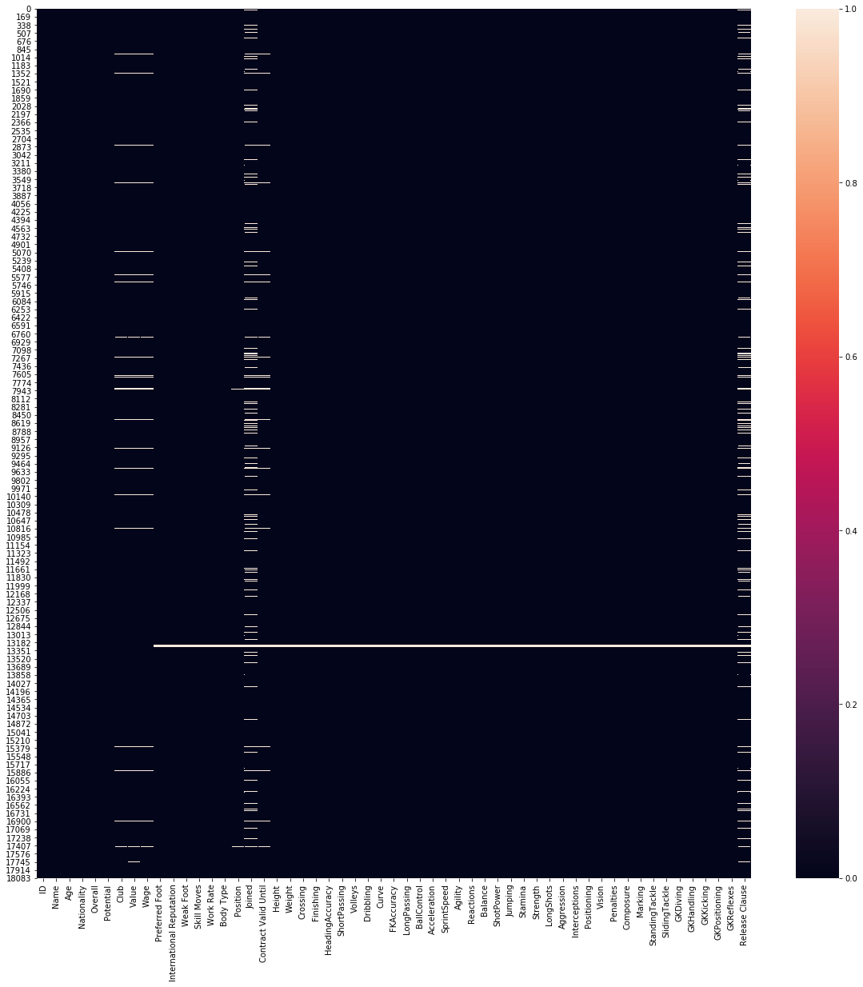
EDA of FIFA dataset
Dataset consists of 18201 rows and 60 columns.
There are float64(38), int64(4), object(18) data types
5 columns are dropped as they are not aiding for EDA.
49 columns consists Nan values.

Slide 2
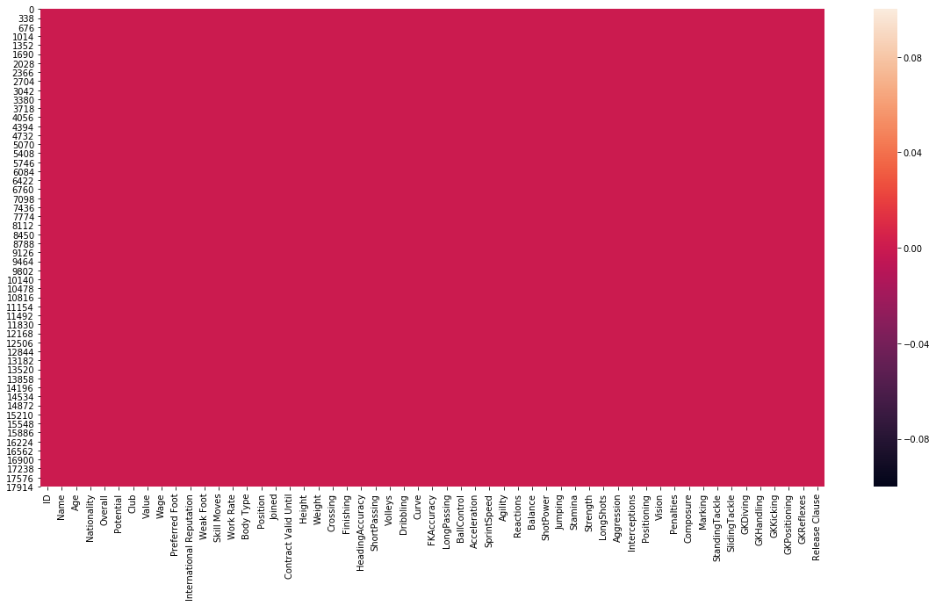
EDA of FIFA dataset
Columns like Value, Wage and Release Clause has ‘€’ as currency in values. This symbol has been stripped
Values, Wage and Release Clause values posses M and K symbolizing millions and thousand. Values is equated.
Height, Weight, Joined and Contract Valid Until columns are converted to integer format.
All the columns with Nan values are filled appropriately.

Slide 3
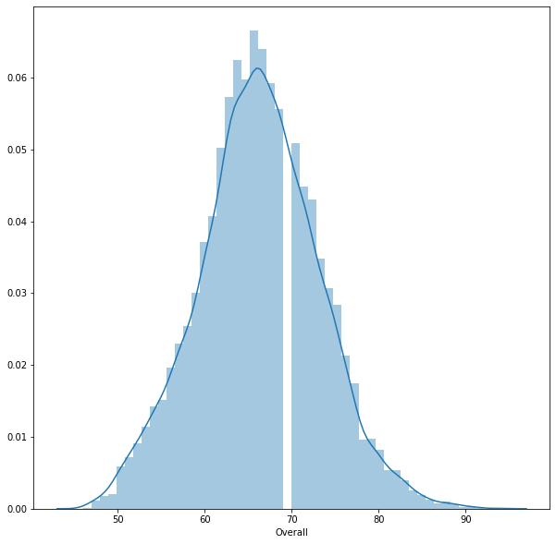
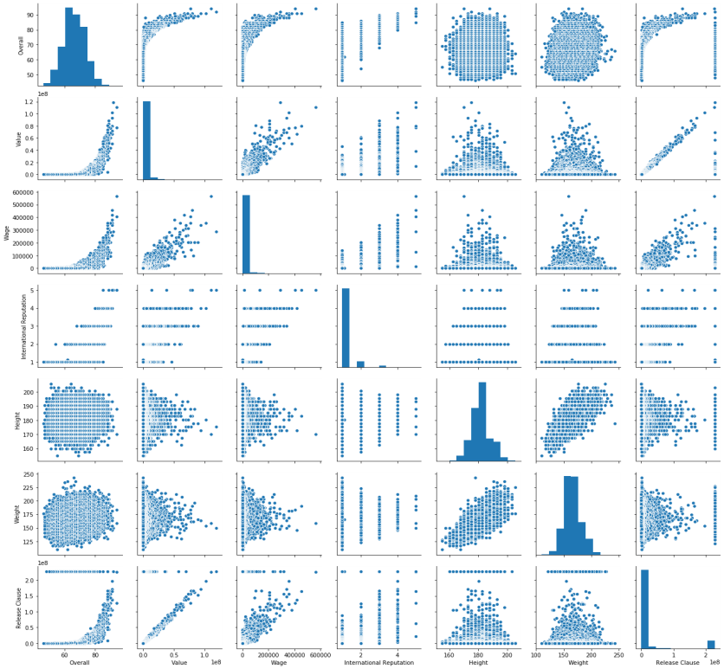
EDA of FIFA dataset
Overall rating of players are distributed normally with maximum values ranging between 65 to 70. Very few players posses 90+ rating.
Pair plot of Overall, Value, Wage, International Reputation, Height, Weight, Release Clause. Distribution can be observed.

Slide 4
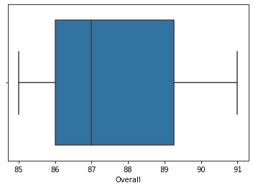
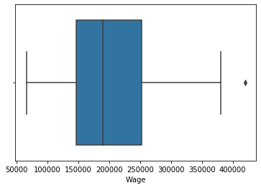
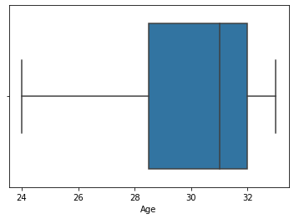
EDA of FIFA dataset
Top 20 players ranked by Overall score and whose contract expires in 2020.
Top 20 players ranked by Overall score, whose contract expires in 2020. Their average wage is 205150.0 and age is 29.95

Slide 5
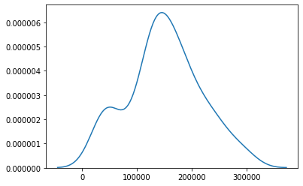
EDA of FIFA dataset
Average wage one can expect to pay for the top 5 in every position
Average wage for LDM is 126600.0
Average wage for LS is 130200.0
Average wage for RS is 132200.0
Average wage for RWB is 44200.0
Average wage for LWB is 34200.0
Average wage for CF is 47400.0
Average wage for RAM is 45400.0
Average wage for LAM is 81600.0
Average wage for RF is 148000.0
Average wage for LF is 121200.0
Average wage for ST is 294000.0
Average wage for GK is 192800.0
Average wage for CB is 139600.0
Average wage for CM is 130600.0
Average wage for LB is 177200.0
Average wage for RB is 155400.0
Average wage for RM is 131400.0
Average wage for LM is 164600.0
Average wage for CAM is 174000.0
Average wage for CDM is 217000.0
Average wage for RCB is 231000.0
Average wage for LCB is 162000.0
Average wage for LCM is 184400.0
Average wage for RCM is 240800.0
Average wage for LW is 261000.0
Average wage for RW is 202000.0
Average wage for RDM is 105000.0

